Slide 1

External Project Presentation of Computer Networking(CSE 3034) on Real-time VoWi-Fi Audio Streaming
Presented by
Sumit Saha(2141019013)
Rishabh Kumar Agrahari(2141001083)
Vs Prudhvi Rajeev Kumar(2141011145)
Sibasish Padhy(2141016014)
Talha Ayub(2141001071)
Utkarsh Mishra(2141013143)
Supervisor
Mrs.Jhilirani Nayak
Department of Computer Science and Engineering
Institute of Technical Education & Research (FET)
Siksha ‘O’ Anusandhan Deemed to be University, Bhubaneswar
Jan, 2024

Slide 2
Contents
Introduction
Problem statement
Methodology
Implementation
Result and Interpretation
Conclusion

Slide 3
Introduction
Voice over Wi-Fi (VoWi-Fi) has emerged as a crucial component in contemporary communication systems, leveraging the ubiquity of Wi-Fi networks for seamless voice transmission. In response to the escalating demand for efficient voice communication over wireless networks, this project endeavors to design and implement a fundamental VoWi-Fi system. The primary objective is to establish a reliable audio transmission mechanism within a single access point, achievedThe primary goal of this project is to create a VoWi-Fi system that captures audio input from a microphone on the client side, transmits it over a local network using socket programming, and facilitates playback on the server side. This comprehensive system aims to demonstrate the essential elements of real-time audio transmission and reception over Wi-Fi networks. through the utilization of socket programming.

Slide 4
Problem Statement
The project addresses the challenge of implementing a fundamental Voice over Wi-Fi (VoWi-Fi) system within a single access point using socket programming. The primary problem involves the seamless flow of audio data from a client-side microphone to a server-side playback mechanism over a local network. The user interacts with the system by capturing audio elements through the microphone, which are then transmitted using socket programming. The desired result is the accurate playback of the audio on the server side. The project aims to establish a reliable and efficient solution for real-time audio communication over Wi-Fi networks.

Slide 5
Methodology
VoWiFiClient :
Set Up Connection:
➢ Set the server's IP address and port.
Open Microphone:
➢ Define audio format (e.g., 16kHz, 16-bit, mono, signed, little-endian).
➢ Get the target data line for capturing audio.
➢ Open and start the target data line.
Create Socket Connection:
➢ Create a socket to connect to the server.
➢ Get the output stream from the socket.
Capture and Send Audio Loop:
➢ Create a buffer for audio data (e.g., byte array of 1024 bytes).
➢ Enter an infinite loop:
▪ Read audio data from the target data line into the buffer.
▪ Write the audio data to the output stream of the socket.

Slide 6
Methodology
VoWiFiServer :
Set Up Server:
➢ Set the server port.
Create Server Socket:
➢ Create a server socket to listen for incoming connections.
Accept Client Connection:
➢ Accept a client connection when a client connects.
➢ Print the client's IP address.
Open Speakers:
➢ Define audio format (e.g., 16kHz, 16-bit, mono, signed, little-endian). ➢ Get the source data line for playing audio.
➢ Open and start the source data line.

Slide 7
Methodology
Create Buffer for Receiving Audio:
➢ Create a buffer for receiving audio data (e.g., byte array of 1024 bytes).
Receive and Play Audio Loop:
➢ Get the input stream from the socket.
➢ Enter an infinite loop:
▪ Read audio data from the input stream into the buffer.
▪ Write the audio data to the source data line for playback

Slide 8
Implementation
ClientSide:
import javax.sound.sampled.*;
import java.io.*;
import java.net.Socket;
public class clientSide {
public static void main(String[] args) {
try {
String serverIp = "192.168.1.11";
int serverPort = 12345;
AudioFormat audioFormat = new AudioFormat(16000, 16, 1, true, true);
DataLine.Info info = new DataLine.Info(TargetDataLine.class, audioFormat);
TargetDataLine targetDataLine = (TargetDataLine) AudioSystem.getLine(info);
targetDataLine.open(audioFormat);
targetDataLine.start();
System.out.println("Microphone opened. \nConnecting to the server...");

Slide 9
Implementation
System.out.println(" ");
Socket socket = new Socket(serverIp, serverPort);
OutputStream outputStream = socket.getOutputStream();
System.out.println("Connected to the server. \nStarting audio transmission...");
byte[] buffer = new byte[1024];
while (true) {
int bytesRead = targetDataLine.read(buffer, 0, buffer.length);
outputStream.write(buffer, 0, bytesRead);
}
} catch (Exception e) {
e.printStackTrace();
}
}
}

Slide 10
Implementation
ServerSide:
import javax.sound.sampled.*;
import java.io.*;
import java.net.ServerSocket;
import java.net.Socket;
public class serverSide {
public static void main(String[] args) {
try {
int serverPort = 12345;
System.out.println("Server is starting...");
ServerSocket serverSocket = new ServerSocket(serverPort);
System.out.println("Server is listening on port " + serverPort);
System.out.println("Waiting for a client to connect...\n");
Socket socket = serverSocket.accept();`
System.out.println("Client connected: " + socket.getInetAddress().getHostAddress());
AudioFormat audioFormat = new AudioFormat(16000, 16, 1, true, true);

Slide 11
Implementation
DataLine.Info info = new DataLine.Info(SourceDataLine.class, audioFormat);
SourceDataLine sourceDataLine = (SourceDataLine) AudioSystem.getLine(info);
sourceDataLine.open(audioFormat);
sourceDataLine.start();
System.out.println("Speakers opened \nReceiving and playing audio...");
byte[] buffer = new byte[1024];
InputStream inputStream = socket.getInputStream();
while (true) {
int bytesRead = inputStream.read(buffer, 0, buffer.length);
sourceDataLine.write(buffer, 0, bytesRead);
}
} catch (Exception e) {
e.printStackTrace();
}
}}

Slide 12
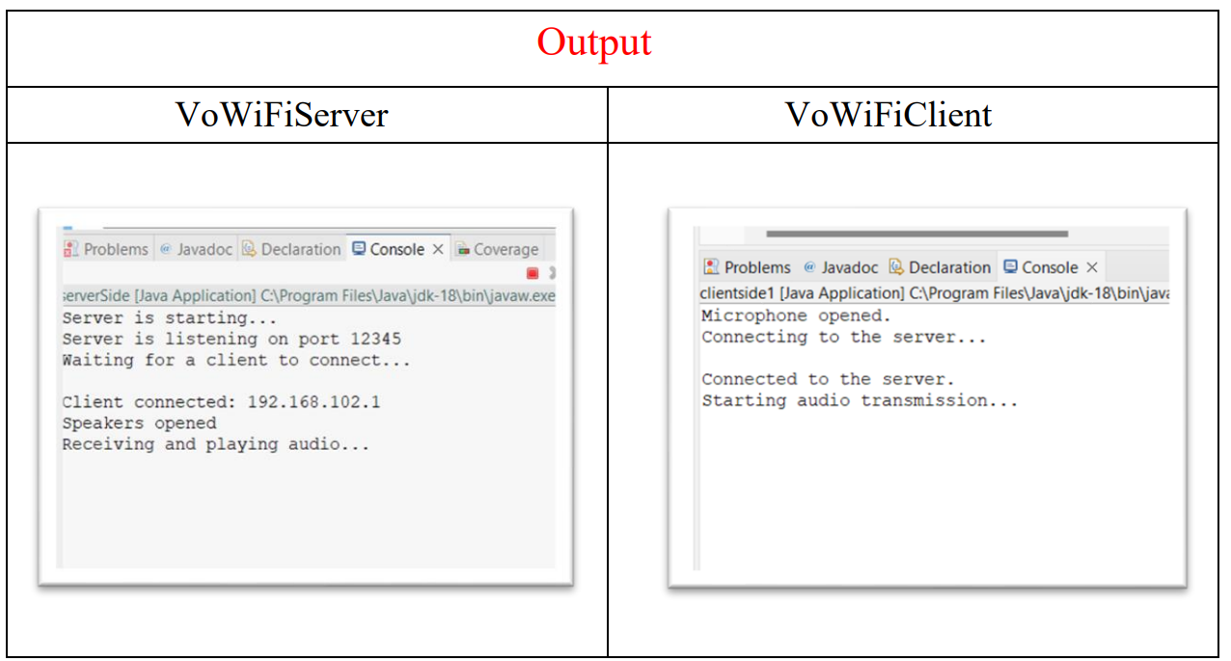
Result and Interpretation
The client captures audio in continuous 1024-byte chunks from the microphone, enabling real-time transmission to the server, which then continuously plays back the received audio data through the speakers, creating a seamless real-time streaming effect and allowing immediate listening to what the client is capturing through its microphone.

Slide 13
Conclusion
In summary, this project successfully implements a robust Voice over Wi-Fi (VoWi-Fi) system using Java socket programming. The achievement of a seamless socket connection between the client and server enables efficient audio transmission, highlighting a significant advancement in client-server communication. The system excels in real-time audio streaming, swiftly capturing and playing back audio from the client's microphone on the server side. The code's well-orchestrated execution flow ensures a continuous process where the client captures audio, sends it to the server in manageable chunks, and experiences uninterrupted playback. In essence, this project lays a strong foundation for VoWi-Fi systems, showcasing the capabilities of Java socket programming in achieving real-time communication over a local network.

Slide 14
References
Oracle Documentation for Java Sound API: https://docs.oracle.com/javase/8/docs/technotes/guides/sound/
Java Tutorials - Networking Basics: https://docs.oracle.com/javase/tutorial/networking/index.html
Java Socket Programming Tutorial:
https://www.javatpoint.com/socket-programming

Slide 15


Slide 16


